Slide 1

Behaviour, Communication and Language
Wednesday 23rd September

Slide 2
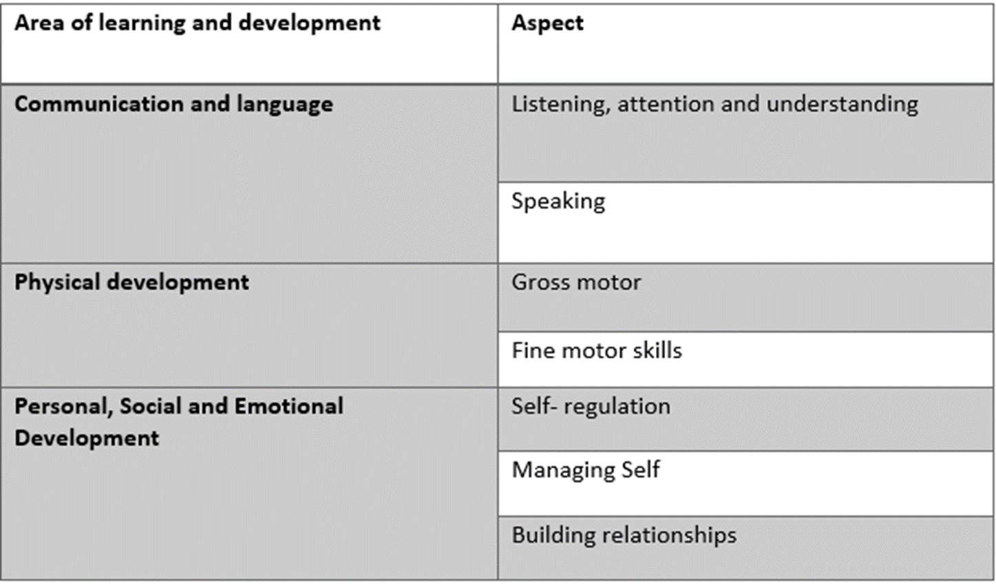
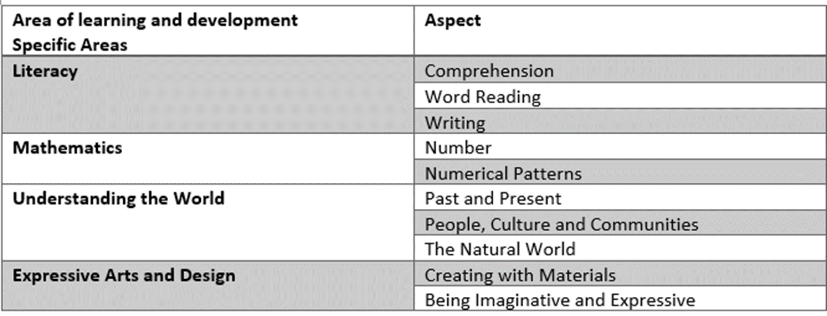

Slide 3

Behaviour
Takes time- No quick fix- Time consuming
Area of learning- Personal, Social and Emotional Development
Self-Regulation Early Learning Goal (ELG)
Children at the expected level of development will:
show an understanding of their own feelings and those of others, and begin to regulate their behaviour accordingly;
set and work towards simple goals, being able to wait for what they want and control their immediate impulses when appropriate; -
give focused attention to what the teacher says, responding appropriately even when engaged in activity, and show an ability to follow instructions involving several ideas or actions.
So what does this mean??

Slide 4
Behaviour
How can we help at home?
Talk about feelings, talk about how other people might be feeling
Regulate behaviour
Make children wait - give them a challenge: ‘I am going to do this so can you….’
Help them to deal with changes to plans
Talk about the appropriateness of different behaviour in different situations
Give them responsibility, a series of things to do - simple instructions

Slide 5
Behaviour
Area of learning- Personal, Social and Emotional Development
Managing Self Early Learning goal
Children at the expected level of development will:
be confident to try new activities and show independence, resilience and perseverance in the face of challenge;
explain the reasons for rules, know right from wrong and try to behave accordingly;
So what does this mean?
Time
not helping or letting them win,
not having everything done or given to them
explain why we have rules and set some rules at home
Takes time - No quick fix - Time consuming

Slide 6
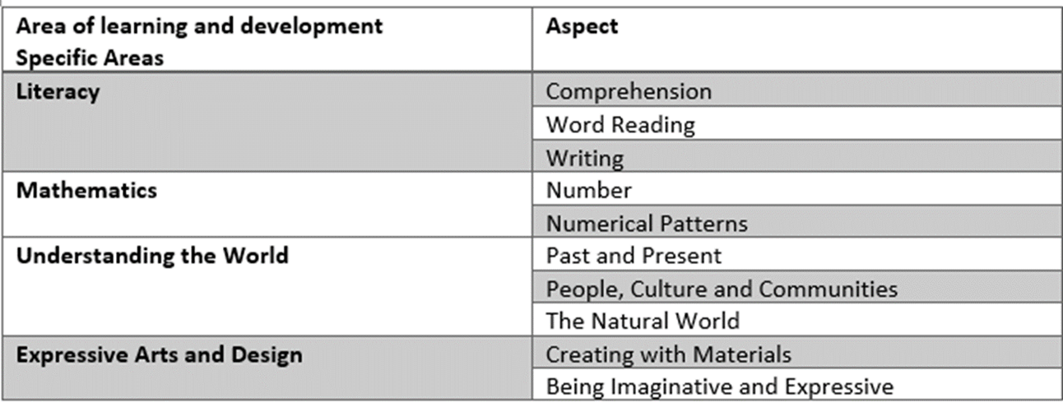

Slide 7
Communication and Language
Institute of Education
‘the combined effect on children’s progress at 16 of regularly reading books and newspapers and visiting the library is four times greater than the advantage children gained from having a parent with a degree.’
Developing children’s spoken language is the key to reading and writing
‘become a fluent, skilled and attentive reader starts at the earliest stages, before children encounter a book for the first time, partly driven by the quality of their parents talk with them that expands their vocabulary’.
Engage children in reading books and it prepares them to become committed and enthusiastic readers
Book related talk introduces children to language that they might not hear in ordinary conversations.

Slide 8
Communication and Language
Impact of parents reading with their children
Here are how many words children would have heard by the time they are 5 years old:
Never read to = 4,662 words
1-2 times per week = 63,570 words
3-5 times per week = 169,520 words
Daily = 296,660 words
5 books a day = 1,483,300 words

Slide 9
Communication and Language
ELG: Listening, attention and understanding
Listen attentively and respond to what they hear with relevant questions, comments and actions when being read to and during whole class discussions and small group interactions; - Make comments about what they have heard and ask questions to clarify their understanding; - Hold conversation when engaged in back-and-forth exchanges with their teacher and peers.
ELG: Speaking
Children at the expected level of development will: - Participate in small group, class and one-to-one discussions, offering their own ideas, using recently introduced vocabulary;
Offer explanations for why things might happen, making use of recently introduced vocabulary from stories, non-fiction, rhymes and poems when appropriate;
Express their ideas and feelings about their experiences using full sentences, including use of past, present and future tenses and making use of conjunctions, with modelling and support from their teacher.

Slide 10
Attention
How can we help at home?
Focused attention- listening on the carpet in small groups ,not getting distracted and tuning in
PLAY - children need practise at play – modelling
TIME - conversations round the table, role play, small world, board games, simple games - no quick fixes
  The only way children learn to focus is with practice. If they are moved from place to place/activity to activity with no interaction and on a tablet they don’t learn to focus
  Without this focused attention, children will miss much of the learning in Reception because they will spend most of the year developing their focused attention.
  End of Reception goal for writing is to write a sentence. Some children do not achieve this not because of their phonics but because of their ability to focus.
  Over timetabling

Slide 11
Communication and Language
What can we do to help?
Behaviour and C&L are linked
PLAY
Make time to talk
Back and forth interactions
Number and quality of conversations with adults is crucial – TALK, TALK, TALK!
Reading frequently to children, and engaging them actively in stories, non-fiction, rhymes and poems, and then providing them with extensive opportunities to use and embed new words in a range of contexts, will give children the opportunity to thrive.
Huge focus on children making use of recently introduced vocabulary from books

Slide 12
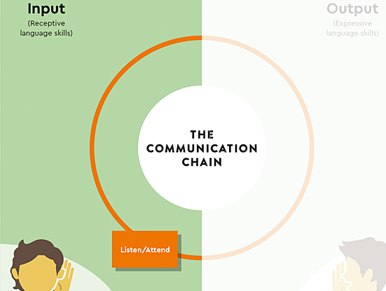
Communication and Language
Learning to listen and pay attention
Listening
Being able to listen and pay attention are complex skills that develop from an early age. Some children have had more experience than others of ‘good listening’ practices from conversations at home, but all children have to learn to develop their listening skills when they enter school.
Listen to this audio clip. While you do, put yourself in the place of a child in this classroom and think about how they might be feeling.

Slide 13
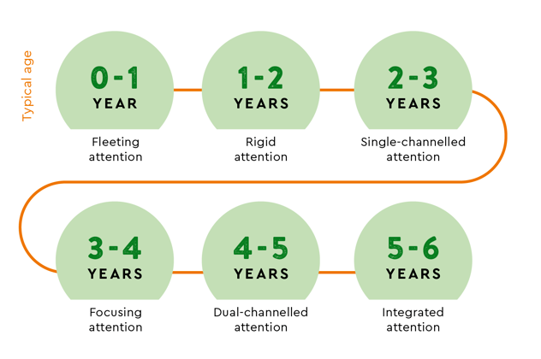
Communication and Language
In order to listen well, we have to be able to pay attention. We’re not born with the ability to pay attention, listen to one thing and ignore everything else. This is a skill we all have to learn and this means that there are stages of development. If we know what these are, it can help us to understand why children behave in certain ways.

Slide 14
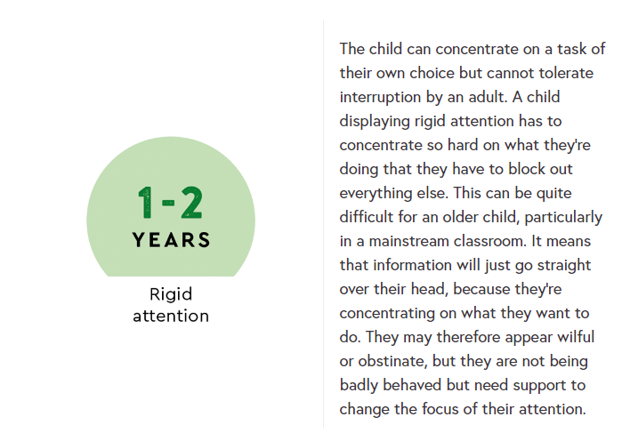
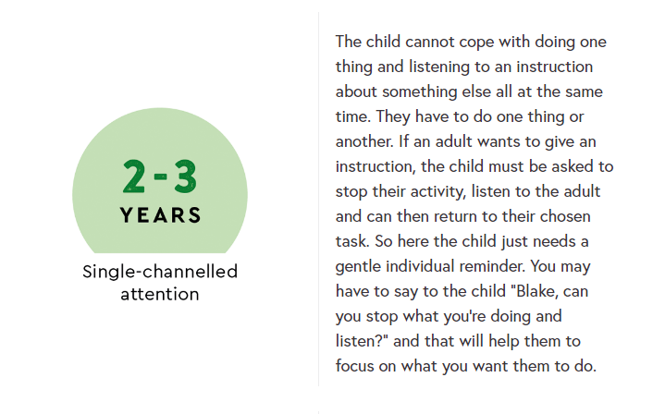
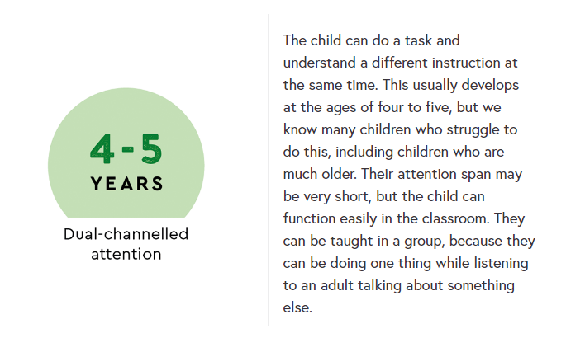
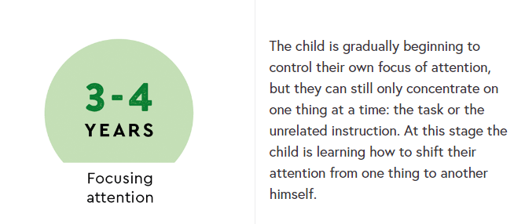

Slide 15
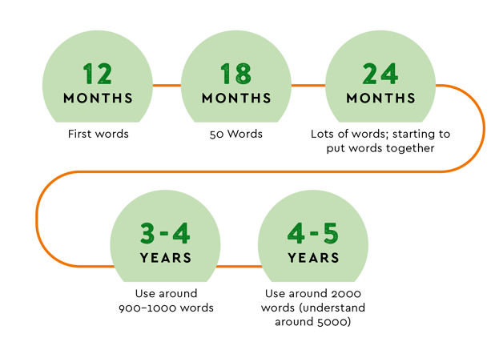
Communication and Language
Building Vocabulary
The most important thing children need in order to choose words is a good bank of words they know how to use.
As we saw when we explored receptive language, we know that children understand words before they are able to use them to express themselves, but they still make rapid progress in the number of words they can produce over the first few years of life.
The building blocks of expressive language are just the same as they are for receptive language – there are a huge variety of word types that children need to learn to use.

Slide 16
Communication and Language
Building Vocabulary
The age at which children reach each stage may vary widely. Many things can influence the rate at which a child acquires new words. A child needs varied life experiences, as well as the imagination and ability to think of situations outside their own experience, for words to have meaning and to be able to learn and use them appropriately. Providing lots of opportunities for children to experience and learn about new things is a good way to ensure they have more words to use when they are talking.

Slide 17
Support at school
Time to talk
Social interaction groups
Language development groups
Speech therapy
Listening and attention groups

Slide 18
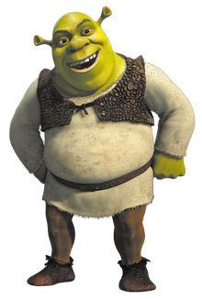
Communication and Language
Sh: Share attention – be at the child’s level. Pay close attention to what they are focused on.
R: Respond – follow the child’s lead. Respond to their non-verbal and verbal communication. You could make a brief comment on what they can see, hear or feel.
E: Expand – repeat what the child says and build on it by adding more words to turn it into a sentence.
C: Conversation – have extended back and forth interactions. Give children time to listen, process and reply.

Slide 19
TIME
All children want and need is time
Time to play
Children remember the small things
Changing mind sets- slowing down

