Slide 1

Little Wandle
Parent Meeting
Wednesday 9th September 2026
We are family • All are welcome • You are loved

Slide 2

What is Little Wandle?
Little Wandle Letters and Sounds Revised is a systematic synthetic phonics programme used in many UK schools.
It helps children make connections between that sounds of spoken language (phonemes) and the written graphemes (letters and letter combinations).
It supports children in learning to decode (sound out words) blend them into reading and segment words for spelling.
The programme is research based, aligned to National Curriculum expectations and includes decodable books, a clear progression of teaching sounds and built in ‘keep up’ sessions for children who need extra support
We are family • All are welcome • You are loved

Slide 3
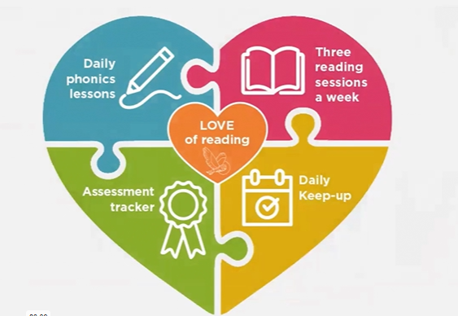
Why are we doing this?
As a school we are passionate about phonics.
Fluency - we wanted to increase the children’s fluency in reading.
Fluency comprises of accuracy, automaticity and expression (prosody) reading with intonation, rhythm and phrasing so it sounds like talking.
While RWI has served the school well, we are always striving to refine our approach to phonics to ensure a more consistent, fluency-focused approach.
Transitioning to Little Wandle has provided a platform to embed greater consistency, address identified gaps, and support stronger long-term reading outcomes for all pupils.
By building fluency now, we are not just teaching your child to read words, we are helping them become confident readers who understand and enjoy what they read.
We are family • All are welcome • You are loved

Slide 4
Why are we doing this?
Little Wandle approach:
Reduces cognitive overload.
Repeated practise.
A structured and consistent teaching framework aligned with fidelity to SSP principles.
Matched decodable texts that precisely align with pupils’ taught GPCs.
An embedded focus on fluency, prosody, and automaticity.
Comprehensive staff training and support, ensuring high-quality delivery across all year groups
Whole class teaching.
We are family • All are welcome • You are loved
Notes:
Becoming a fluent reader is a complex process that requires an integration of both word reading and language comprehension, as shown in the Scarborough reading rope. At a very simple level, comprehension of any written text is affected by the reader’s background knowledge and their ability to connect to and understand the vocabulary and language of the text. Connecting to a text is foundational to understanding it. And more than that, the reader’s flexibility of thinking and reservoir of knowledge help them bring the text to life. A successful reader creates the text in their minds moment by moment, creating an accurate mental model of what they read.

Slide 5
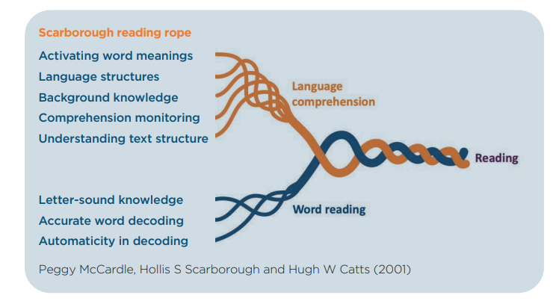
Why are we doing this?
We are family • All are welcome • You are loved
Notes:
Becoming a fluent reader is a complex process that requires an integration of both word reading and language comprehension, as shown in the Scarborough reading rope. At a very simple level, comprehension of any written text is affected by the reader’s background knowledge and their ability to connect to and understand the vocabulary and language of the text. Connecting to a text is foundational to understanding it. And more than that, the reader’s flexibility of thinking and reservoir of knowledge help them bring the text to life. A successful reader creates the text in their minds moment by moment, creating an accurate mental model of what they read.

Slide 6
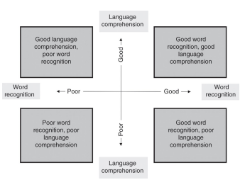
Why are we doing this?
We are family • All are welcome • You are loved
Notes:
Becoming a fluent reader is a complex process that requires an integration of both word reading and language comprehension, as shown in the Scarborough reading rope. At a very simple level, comprehension of any written text is affected by the reader’s background knowledge and their ability to connect to and understand the vocabulary and language of the text. Connecting to a text is foundational to understanding it. And more than that, the reader’s flexibility of thinking and reservoir of knowledge help them bring the text to life. A successful reader creates the text in their minds moment by moment, creating an accurate mental model of what they read.

Slide 7
Terminology
Orthographic store - Children learn to read by first sounding and blending words, and then reading them ‘straight off’, without overt sounding and blending. Once this has been practised sufficiently, recognition of these words becomes automatic and they are held as an orthographic store in a highly specialised area of the brain that expert neurologist Stanislas Dehaene calls ‘the brain’s letterbox’. This orthographic store, and the instantaneous recall it enables, is the basis of fluent reading.
Phoneme - the smallest unit of sounds that can be identified in words, we sometimes simple call this a sound but we will be using the term phoneme.
Grapheme - a letter of group of letter used to represent a particular phoneme when writing.
GPC - this stands for grapheme -phoneme correspondence. Written English is very complex and does not have one to one grapheme- phoneme correspondence. The same phoneme can be represented by different graphemes in different words and the same grapheme can represent different phonemes in different words. To ensure learning is synthetic and to avoid cognitive overload the programme teaches one fairly common grapheme representation of each phoneme first. Alternative spellings of the same phoneme and alternative pronunciation of the same grapheme are usually taught later.
We are family • All are welcome • You are loved

Slide 8
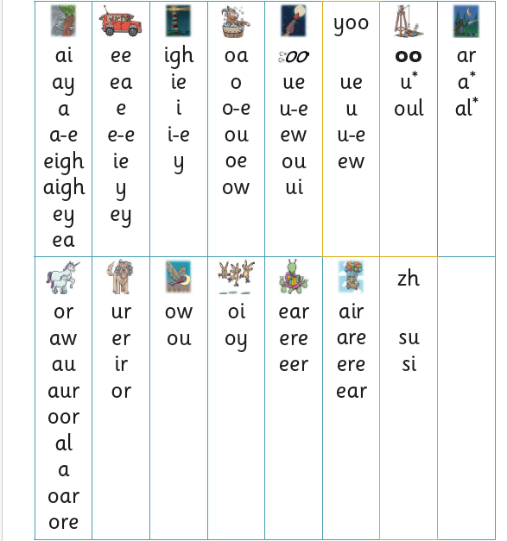
Grow the code
26 letters, 44 sounds, 150+ graphemes
To teach additional GPCs so that the range of words children can read continually extends.
We are family • All are welcome • You are loved

Slide 9
Terminology
Diagraph - a grapheme using two letters to represent one phoneme. With children we use the mantra ‘two letters one sound’.
Trigraph - a grapheme using three letters to represent one phoneme. With the children we use the mantra ‘three letters one sound’.
Split vowel diagraph - a diagraph representing a vowel sound where its two letters are split by an intervening consonant. ‘take’.
Blending is when a child listens to separate sounds (phonemes) spoken out loud and then merges them together to say the whole word. Example: An adult says c-a-t, and the child puts the sounds together to say cat. It’s like “sound talk” → hearing the parts, then saying the whole. Once children are more confident they will begin to blend in their head.
Chunk it up - to break up a longer word and read it one part at a time.
Segment - to identify each of the sounds in a word, an important stage of writing a word but needs to be practice orally first.
Tricky word - cannot be sounded out by children using the GPC’s they have been taught up to that point e.g. ‘was’
We are family • All are welcome • You are loved

Slide 10
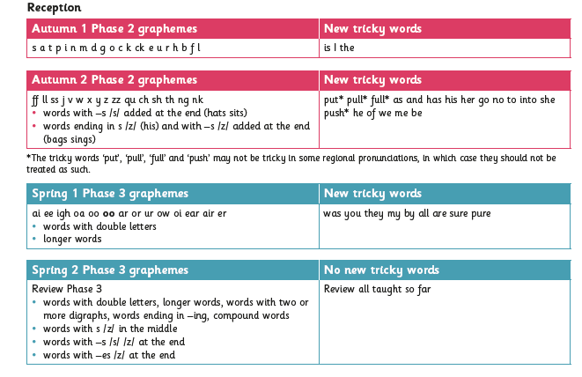
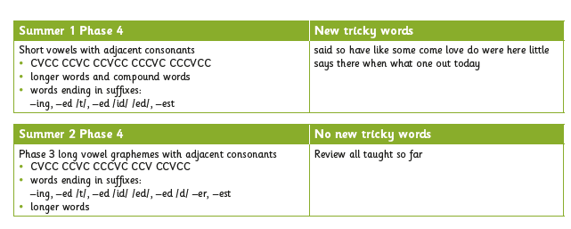
Phonic Phases
We are family • All are welcome • You are loved

Slide 11
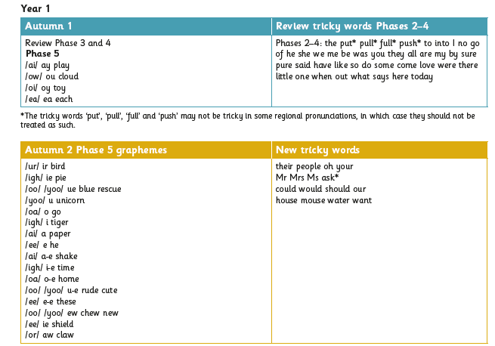
Phonic Phases
We are family • All are welcome • You are loved

Slide 12
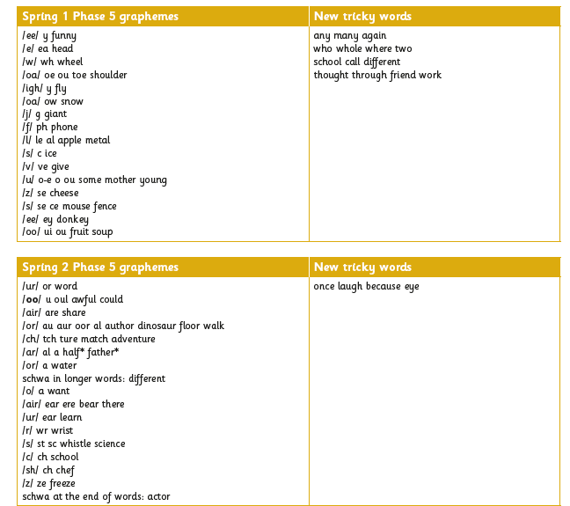
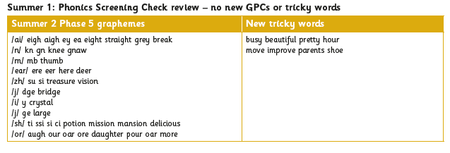
Phonic Phases
We are family • All are welcome • You are loved

Slide 13
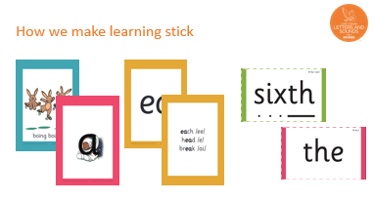
Practice makes permanent
Reducing cognitive overload.
Orthographic store.
There are specific resources for the Little Wandle programme which the children will be very familiar with.
Each sound that we teach to begin with has either a mnemonic (like the astronaut that you can see here) or a phrase like boing-boing for ‘oi’. This helps the children recognise and remember the graphemes.
Every time we teach a new sound, we also read words during the phonics lesson that contain that new sound so that the children practise what they have learned.
We then go on to reading a sentence containing some of those words.
We have displays in the classroom and on the tables to support the children throughout the day.
Blending games – Reception.
Review days.
Repeated practice .
We are family • All are welcome • You are loved

Slide 14


Reception phonics - Phase 2
Phase 2 are the first group of letters and sounds your child will learn.
We start teaching from week 2 of Reception.
The lessons are fun, interactive, engaging and have been designed to gradually build over time.
We are family • All are welcome • You are loved

Slide 15
Reception phonics
How to say the sounds - video
We teach blending so your child learns to read.
Teacher-led blending is taught throughout Phase 2.
Our aim to is to teach every child to blend by Christmas.
We will inform you if your child needs additional practice.
How we teach blending - video
Tricky Words
These words have unusual spellings e.g. he, the, was.
They are taught in a systematic way.
Children are now learning to read the Phase 2 tricky words: is, I, the, put, pull, full, as, and, has, his, her, go, no, to, into, she, push, he, of, we, me, be.
We are family • All are welcome • You are loved

Slide 16
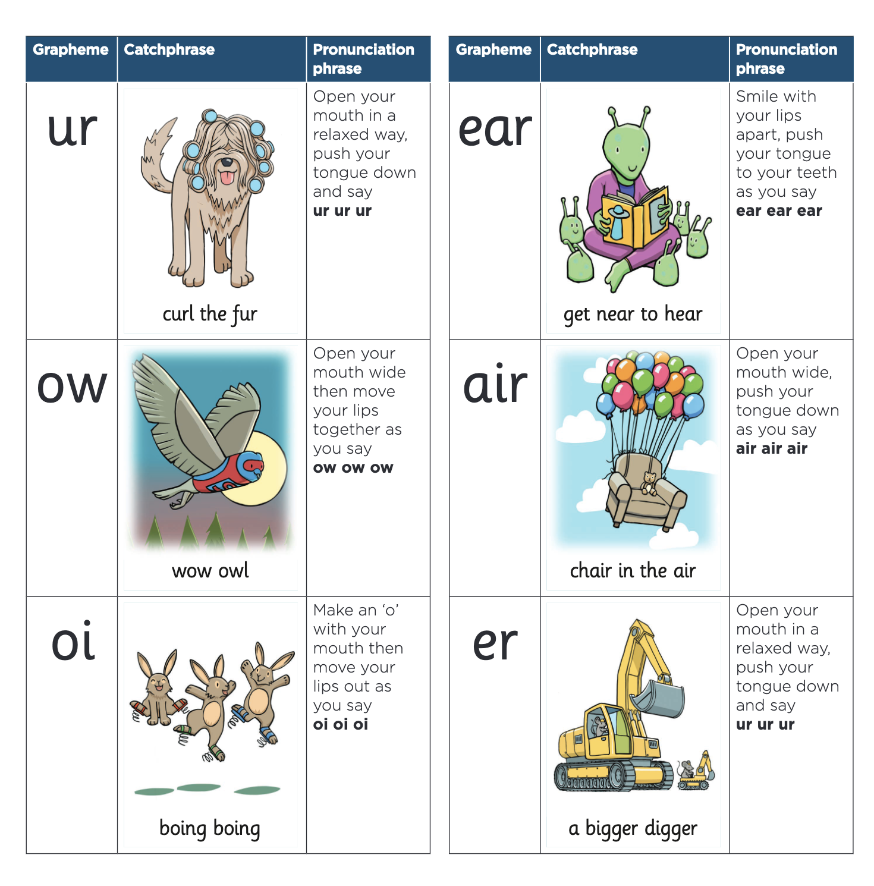
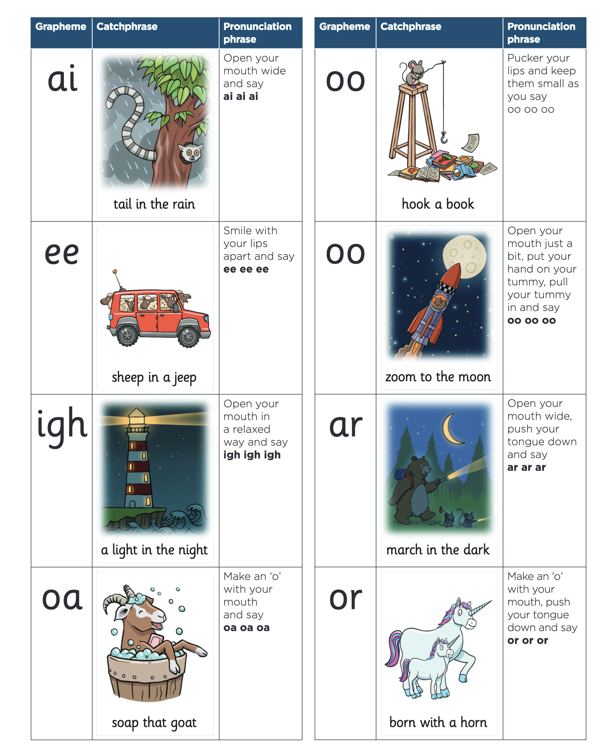
Reception phonics - Phase 3
In Phase 3, children learn:
the vowel digraphs and trigraphs
to read words containing the Phase 3 digraphs and trigraphs
to read longer words (‘chunking’).
We are family • All are welcome • You are loved

Slide 17
Reception phonics - Phase 3
During Phase 2, we taught your child to blend using the teacher-led blending approach.
Now they can start to blend independently.
Children are taught to spot the digraph/trigraph in words first.
Reading longer words
During Phase 3, we start teaching children how to read longer words.
We do this using a method called chunking.
Phase 3 Spelling
Your child will be taught how to spell words every day using the graphemes they have been taught so far.
They will practise writing a dictated sentence.
Handwriting is referred to but is taught at other times of the day.
Say the word.
Segment the sounds.
Count the sounds.
Write them down.
We are family • All are welcome • You are loved

Slide 18
Reception phonics - Phase 4
Phase 4 is all about consolidating and applying the sounds children already know.
No new phonemes are introduced — instead, children practise blending and segmenting longer words and reading tricky words more confidently.
The focus is on fluency and confidence, helping children read more complex words and sentences smoothly.
Children begin reading longer sentences and simple stories, focusing on accuracy, fluency, and understanding.
Phase 4 helps children use all the sounds they’ve learned so far to read longer words and sentences confidently. By practising blending, segmenting, and tricky words, they become fluent and independent readers.
We are family • All are welcome • You are loved

Slide 19
Reception phonics - Spelling
Children will practise the correct formation of letters. They will also have handwriting lessons.
Handwriting will be 4 afternoons a week for 20 mins- sequenced
Your child will be taught how to spell simple words, using the graphemes they have been taught.
Spelling words
Say the word.
Segment the sounds.
Count the sounds.
Write them down.
Spelling video
We are family • All are welcome • You are loved

Slide 20
Keep up and Rapid Catch Up
What it is: Extra, small-group or one-to-one sessions.
Who it’s for: Children who are learning alongside their class but need immediate support to secure a sound, word or skill.
How it works:
  Same content as the class lesson, delivered at the same pace.
  More repetition and practice so children don’t fall behind.
This year, the Keep Up might be slightly different and some children will be recapping sounds they have not remembered from previous years.
Rapid Catch-up
What it is: A structured, longer-term intervention programme.
Who it’s for: Children in Year 2 and above who did not secure phonics earlier and need a second chance to learn systematically.
How it works:
  Tailored sessions with explicit phonics teaching.
  Focused on closing gaps quickly to build fluency and confidence.
  For Keep up session you will not be contacted. However, if your child requires the Rapid Catch Up programme the class teacher and Mrs Questa will arrange a meeting/ phone call with you
We are family • All are welcome • You are loved

Slide 21
Assessment
We use the AFL approach during lessons, teachers a constantly checking children responses during phonics and reading sessions.
This helps us spot if a child is struggling with a sound word or skill straight away.
If needed they get keep up support the same day.
Every 6 weeks children complete a short phonics assessment, this checks which sounds and tricky words they know securely and how well they can blend to read.
Results show whether a child is on track, needs extra support or is ready to move on.
We carry out specific fluency assessments when children are ready in Year 2.
We are family • All are welcome • You are loved

Slide 22
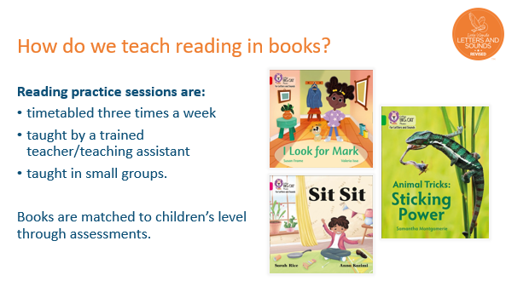
Three Reads
First Read – Decoding
Children sound out words they’ve learned.
Focus is on accuracy: reading each word correctly.
Teachers support children who struggle with tricky words.
Second Read – Prosody (Expression)
Children read the book again, this time with expression and phrasing.
They focus on reading smoothly and sounding like talking.
Teachers model expression and intonation for tricky sentences
Third Read – Comprehension
Children read the book a final time to understand what they are reading.
Teachers ask questions to check meaning, vocabulary, and inference.
This read helps children link decoding to understanding.
We are family • All are welcome • You are loved

Slide 23
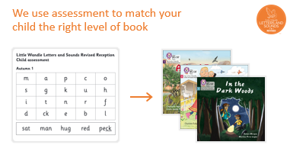
Three Reads
We are family • All are welcome • You are loved

Slide 24
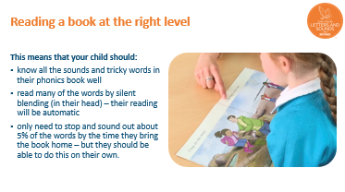
Three Reads
Wordless books are invaluable as they teach reading behaviours and early reading skills to children who are not blending – yet!
Talk about the pictures.
Point to the images in the circles and find them on the page.
Encourage your child to make links from the book to their experiences.
We are family • All are welcome • You are loved

Slide 25
Our expectations for reading at home
If your child can read their decodable book fluently and with confidence, it is NOT too easy for them — it is exactly the right level.
Why this is the expectation?
Little Wandle decodable books are carefully matched to the sounds and words children have been taught.
Reading fluently shows that the child has mastered the phonics skills for that book.
Fluency builds confidence, automaticity, and enjoyment.
How parents can support
Listen to your child read the book. If they read fluently:
  Praise them for smooth, confident reading.
  Talk about the story, pictures, and new vocabulary.
Do not request harder books— children need to solidify skills before moving on.
A book that feels easy is perfect. It helps children practice fluency, build confidence, and prepare for more challenging texts in the future.
We are family • All are welcome • You are loved

Slide 26
Our expectations for reading at home
Bringing reading books to school
Daily return is essential: Children need to bring their decodable books every day to take part in their reading group.
Missing or damaged books: If a book is lost or damaged, parents will be asked to cover the cost of replacement.
Why it matters?
Reading books are carefully matched to your child’s phonics level. If they don’t have their book, they cannot practise fluency, expression, and comprehension in their group session.
Reading books will be handed out on a Tuesday- starting Tuesday 23rd September, these will then be changed weekly
We are family • All are welcome • You are loved

Slide 27
Our expectations for reading at home
Homework will usually focus on practising sounds, tricky words, and reading decodable books that your child has been learning in school. It is short and focused — designed to reinforce what your child has already learned, not to introduce new skills.
Typical homework activities
Reading practice book
Children read the same decodable book they are using in school.
Encourage fluency, expression, and understanding.
Tricky word practice
Flashcards, games, or worksheets to practise words that cannot be sounded out.
Sound or letter revision
Quick activities to review previously taught phonics sounds.
How parents can help
Set aside a short, regular time each day (10–15 minutes) for phonics and reading homework.
Encourage your child to read aloud — listen, praise, and discuss the story.
Use the Little Wandle parent resources for guidance on correct pronunciation and support. (littlewandle.org.uk)
Little Wandle homework is not about extra work — it’s about giving your child a little daily practice to build fluency, confidence, and enjoyment in reading.
We are family • All are welcome • You are loved

Slide 28
Our expectations for reading at home
Reception
Library books sent home on a Monday- these do not need to come back to school each day but must be returned every Monday
Reading books will be sent out every Tuesday- please bring them back every day
Sounds, tricky words, letter formation that we are learning for the week will be sent out every Monday via Tapestry
Rhyme of the Week will be sent out every Friday
Reading videos
We are family • All are welcome • You are loved

Slide 29
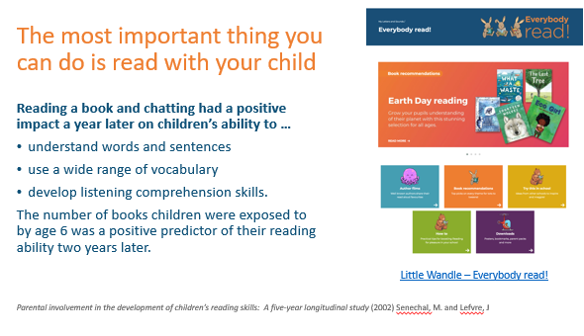
Reading at Home
We are family • All are welcome • You are loved

Slide 30

Reading at Home
As well as the ‘learning to read’ book that your child will bring home they will also bring home a book for sharing with you.
This shared book is SO important. This is how we are going to give them the WILL to read.
Please read with your child as often as you can – at least once a day if possible.
We are family • All are welcome • You are loved

Slide 31
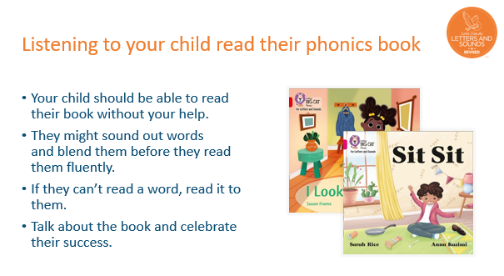
Reading at Home
We are family • All are welcome • You are loved

Slide 32
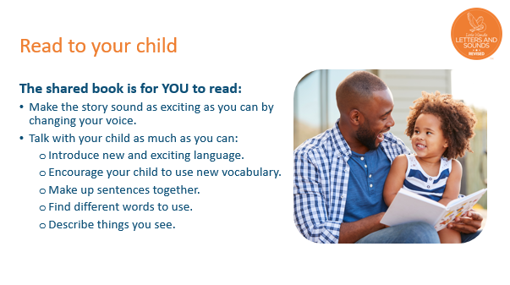
Reading at Home
We are family • All are welcome • You are loved

Slide 33
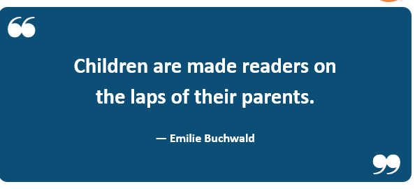
Reading at Home
We are family • All are welcome • You are loved

