Slide 1
Mathematics in Early Years
Wednesday 7th October 2026

Slide 2
Early learning goal- Number
Children at the expected level of development will:
Have a deep understanding of number to 10, including the composition of each number
Subitise (recognise quantities without counting) up to 5
Automatically recall (without reference to rhymes, counting or other aids) number bonds up to 5 (including subtraction facts) and some number bonds to 10, including double facts

Slide 3
Early Learning goal- Numerical patterns
Children at the expected level of development will:
Verbally count beyond 20, recognising the pattern of the counting system
Compare quantities up to 10 in different contexts, recognising when one quantity is greater than, less than or the same as the other quantity
Explore and represent patterns within numbers up to 10, including evens and odds, double facts and how quantities can be distributed equally.

Slide 4
Shape, Space and Measure
No longer an official ELG HOWEVER, the new EYFS Framework states in Mathematics section:
In addition, it is important that the curriculum includes rich opportunities for children to develop their spatial reasoning skills across all areas of mathematics including shape, space and measures. It is important that children develop positive attitudes and interests in mathematics, look for patterns and relationships, spot connections, ‘have a go’, talk to adults and peers about what they notice and not be afraid to make mistakes.
Additionally, SS&M still features strongly in Development Matters and it is essential we still teach these skills alongside Number
Development Matters Statements
Select, rotate and manipulate shapes in order to develop special reasoning skills
Compose and decompose shapes so that children recognise a shape can have other shapes within it, just as numbers can
Continue, copy and create repeating patterns
Compare length, weight and capacity

Slide 5
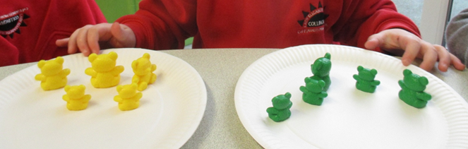
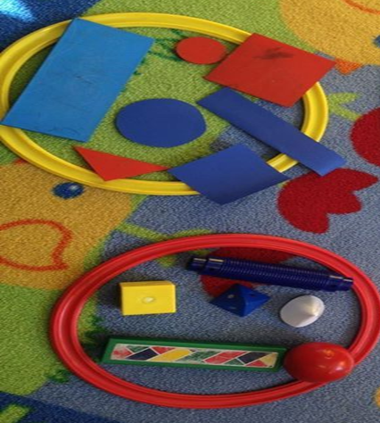
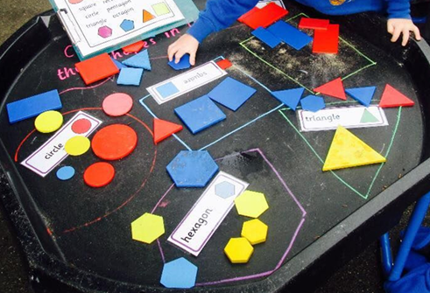
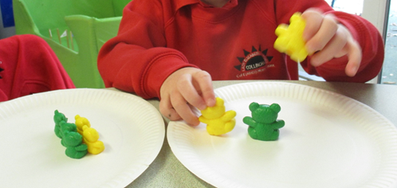
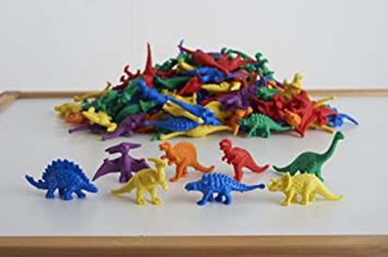
Shape, Space and Measure
Sorting
Logic – Problem Solving - Reasoning
Language - Explanation

Slide 6
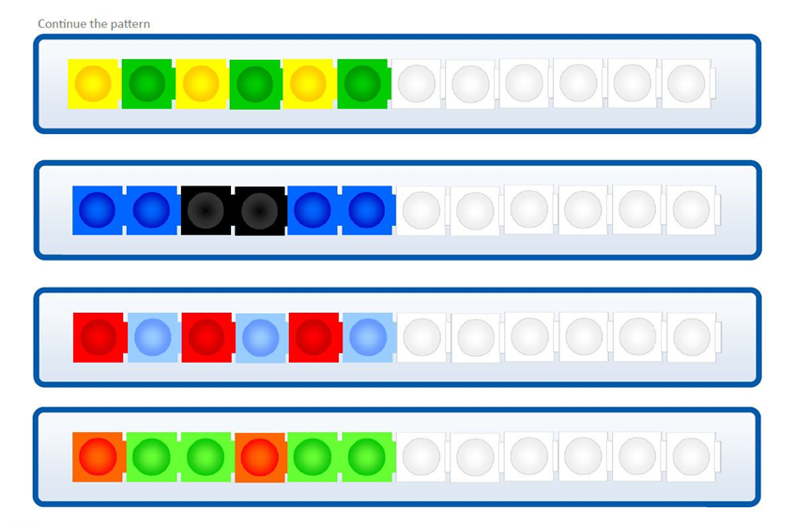
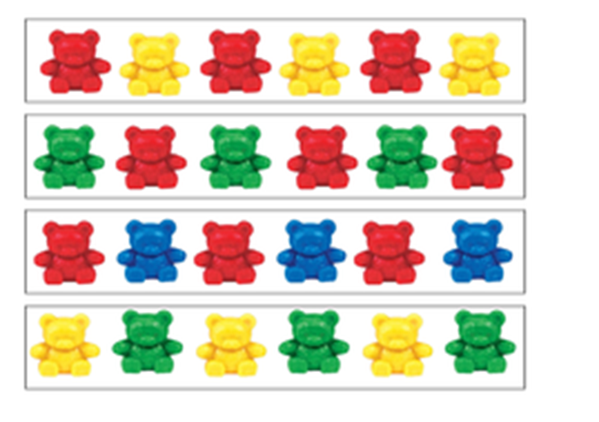
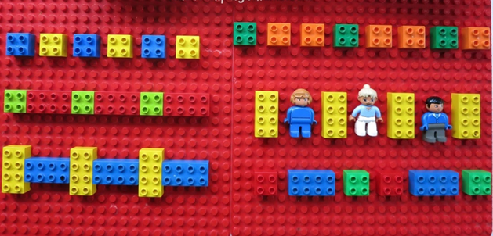
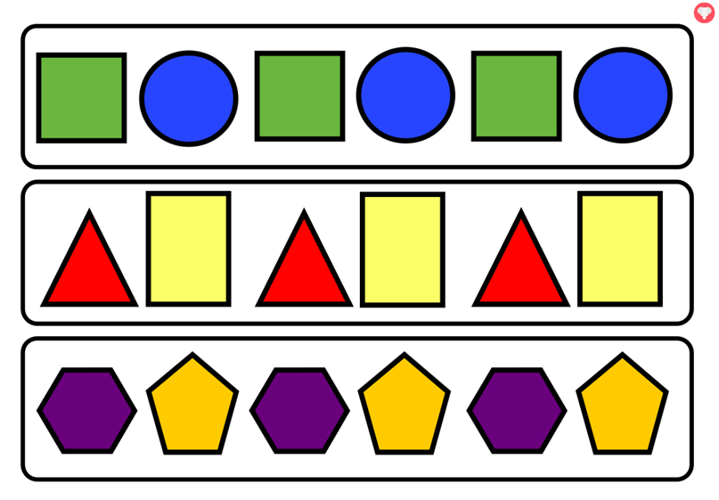
Shape, Space and Measure
Links to number focus
Consolidating and extending number learning through Shape Space and Measure
Pattern
Seeking and exploring patterns is at the heart of mathematics (Schoenfeld, 1992).
Developing an awareness of pattern helps young children to notice and understand mathematical relationships.
Clements and Sarama (2007) identify that patterns may provide the foundations of algebraic thinking, since they provide the opportunity for young children to observe and verbalise generalisations.

Slide 7
The importance of Early mathematics- Counting
Not just ‘simply’ counting- understanding of the numbers the children are counting
Many people consider counting to be a simple skill, but that leads us to be deceived – we often hear young children recite a string of words and assume they can count. (Penny Munn 1977)

Slide 8
Counting: a deceptively simple skill
Children have to learn how to do a number of things consistently in order to count successfully. These are the counting principles.
Stable order
The stable order principle refers to the understanding that numbers must always be said in the same order, i.e. 1, 2, 3, 4, 5 and not 1, 3, 2, 5, 4.
Children count spontaneously from an early age, often saying the numbers in the wrong order. Collaborative play with an adult or older child helps them to develop stable order counting. Counting things out loud and making deliberate mistakes is very effective in helping children to learn the correct counting order.
Counting forwards and backwards- missing out number 15!

Slide 9
Counting: a deceptively simple skill
One-to-one correspondence
One-to-one correspondence refers to the ability to match one object to one number consistently. Without this skill, children will not be able to understand how many objects are in a group (the cardinal value).
Cardinality
Understanding the cardinality principle means that a child appreciates that the last number counted indicates how many things are in the set.
Abstraction
As children become more competent at counting, they begin to understand the abstract nature of number. They can count 5 apples, 5 assorted things from their pocket and even things they cannot see such as 5 steps up to their house or 5 bangs on a drum.

Slide 10
Counting: a deceptively simple skill
Order irrelevance- Conservation of number
Many young children think that counting from one end of a collection of items will give a different answer from counting from the other. Group counting games, along with opportunities to count many different things in different settings, helps them to appreciate that the order does not matter. This is a crucial piece of knowledge when calculating with much larger numbers.
Not all numbers are counting numbers-Some are labels eg. bus numbers
Connecting’ one more’ and ‘one less’
Basic principle to make explicit
The next number after a given number is always one more
More challenging is the complementary principle that the previous number is always one less

Slide 11
Experiencing what it means to learn to count
We have a new number system
i
h
g
f
e
d
c
b
a

Slide 12
Experiencing what it means to learn to count
Show me
i
a
b
h

Slide 13
Experiencing what it means to learn to count
Calculate
i
h
added to

Slide 14
Experiencing what it means to learn to count
Calculate
c
g
subtract

Slide 15
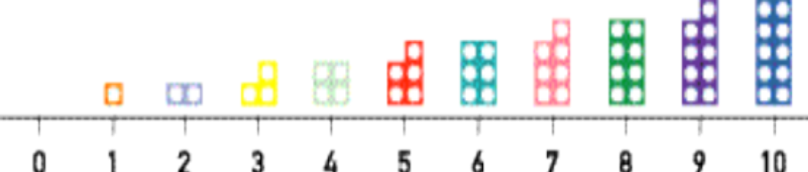
Experiencing what it means to learn to count
What made the task easy?
What made the task difficult?
Would it have been helpful if you had known something else first?
What would have made it easier?
How does this relate to what children in their early years (3-5 years old) experience?
Notes:
What does it feel like to be insecure in a number system?
Did you rely heavily on:
Using your fingers
Counting all strategies
Counting at all stages
Insecurity slows calculation down and results in what Jo Boaler calls a different type of maths

Slide 16
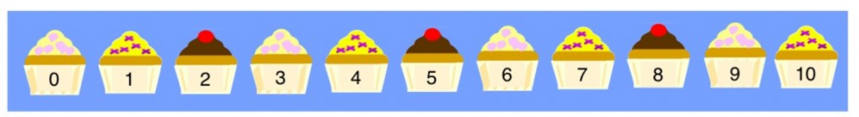
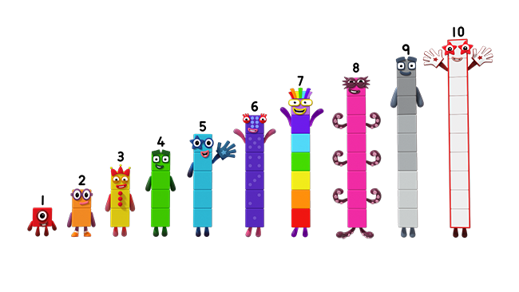
Compare the two images
How do they support the development of cardinality?

Slide 17
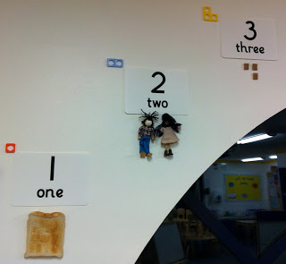
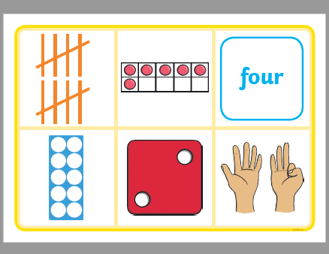
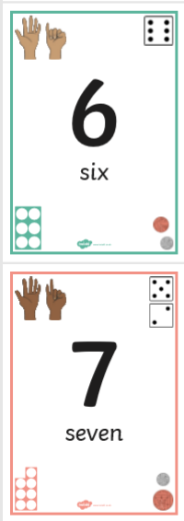
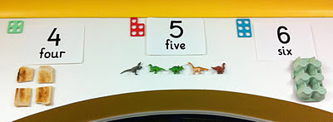
Considering pedagogy….
How do you teach number?
Notes:
START SLOW - must be real alongside abstract?
Children’s interests?
When practicing counting to five I start from a number of different places...
From 1 and point to each number symbol as we move up to 5.
Count all the objects displayed under the number 5.
Count the first 5 of the objects displayed under 8, etc etc.
What about 9 – what can you tell me about this number …………….what else do you know?
Refer back to approach to early maths slide.

Slide 18
Subitising!
Numbers on a dice
Fingers!

Slide 19
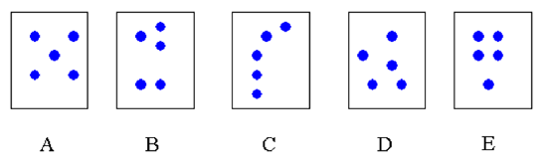
Discuss and share their discoveries and solutions
Notes:
Using fewer than five dots would develop the most basic number sense skills, and using more than five dots would provide opportunities for more advanced strategies.
Cards are shown briefly to children, then the children are asked how many dots they saw. The children should be asked to explain how they perceived the arrangement, and hence what strategies they used.
Card A is the classic symmetrical dice and playing card arrangement of five and so is often instantly recognised without engaging other mental strategies. It is perhaps the easiest arrangement of five to deal with.
Card B presents clear sub-groups of two and three, each of which can be instantly recognised. With practice, the number fact of 'two and three makes five' can be recalled almost instantly.
Card C: A linear arrangement is the one most likely to prompt counting. However, many people will mentally separate the dots into groups of two and three, as in the previous card. Other strategies such as seeing two then counting '3, 4, 5' might also be used.
Card D could be called a random arrangement, though in reality it has been quite deliberately organised to prompt the mental activity of sub-grouping. There are a variety of ways to form the sub-groups, with no prompt in any particular direction, so this card could be considered to be the most difficult one in the set.
Card E shows another sub-group arrangement that encourages the use (or discovery) of the 'four and one makes five' number relation.

Slide 20




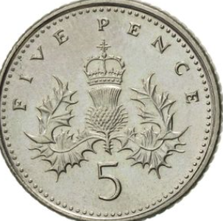




A Concept Image
five
5
0 1 2 3 4 5 6 7 8 9 10
Notes:
It is quite difficult to define a formal concept for 5. we can count to 5, we can give a child 5 sweets, we can point to a pattern on a domino, we can tell a child she is five, we can listen to radio five live, sing about 5 speckled frogs, and read a story about the famous 5.
We can talk about and show : 1 less than 6, one more than 4, a half of 10, and 2 + 3. in these and infinitely more ways we can offer children experiences of 5 that link with each other. This total of developing impressions we call a child’s concept image.
We are not aiming to restrict children’s concept images to numicon visual patterns. We want children to develop rich, broad concept images. For each number there will be found: the numicon visual image/ experience, a position on a number line, a numeral, a word, images using random arrangements for the number counting experience, ‘everyday life interpretations’.

Slide 21
Addition and subtraction
Addition is adding two amounts together- the number gets bigger, we count forward
Subtraction- taking away- the number gets smaller, we count backwards
Manipulatives- numicon, cubes, counters
Number lines
Counting on and back in their head
Reading a number sentence
Maths vocabularly- add, plus, more, less, subtraction, take away, minus, equals, part, part whole,
Number bonds
5 and 10
Games- throwing socks in a wash basket
- take some cubes out of a bag, how many should be left
- numicon
Tens frames

Slide 22
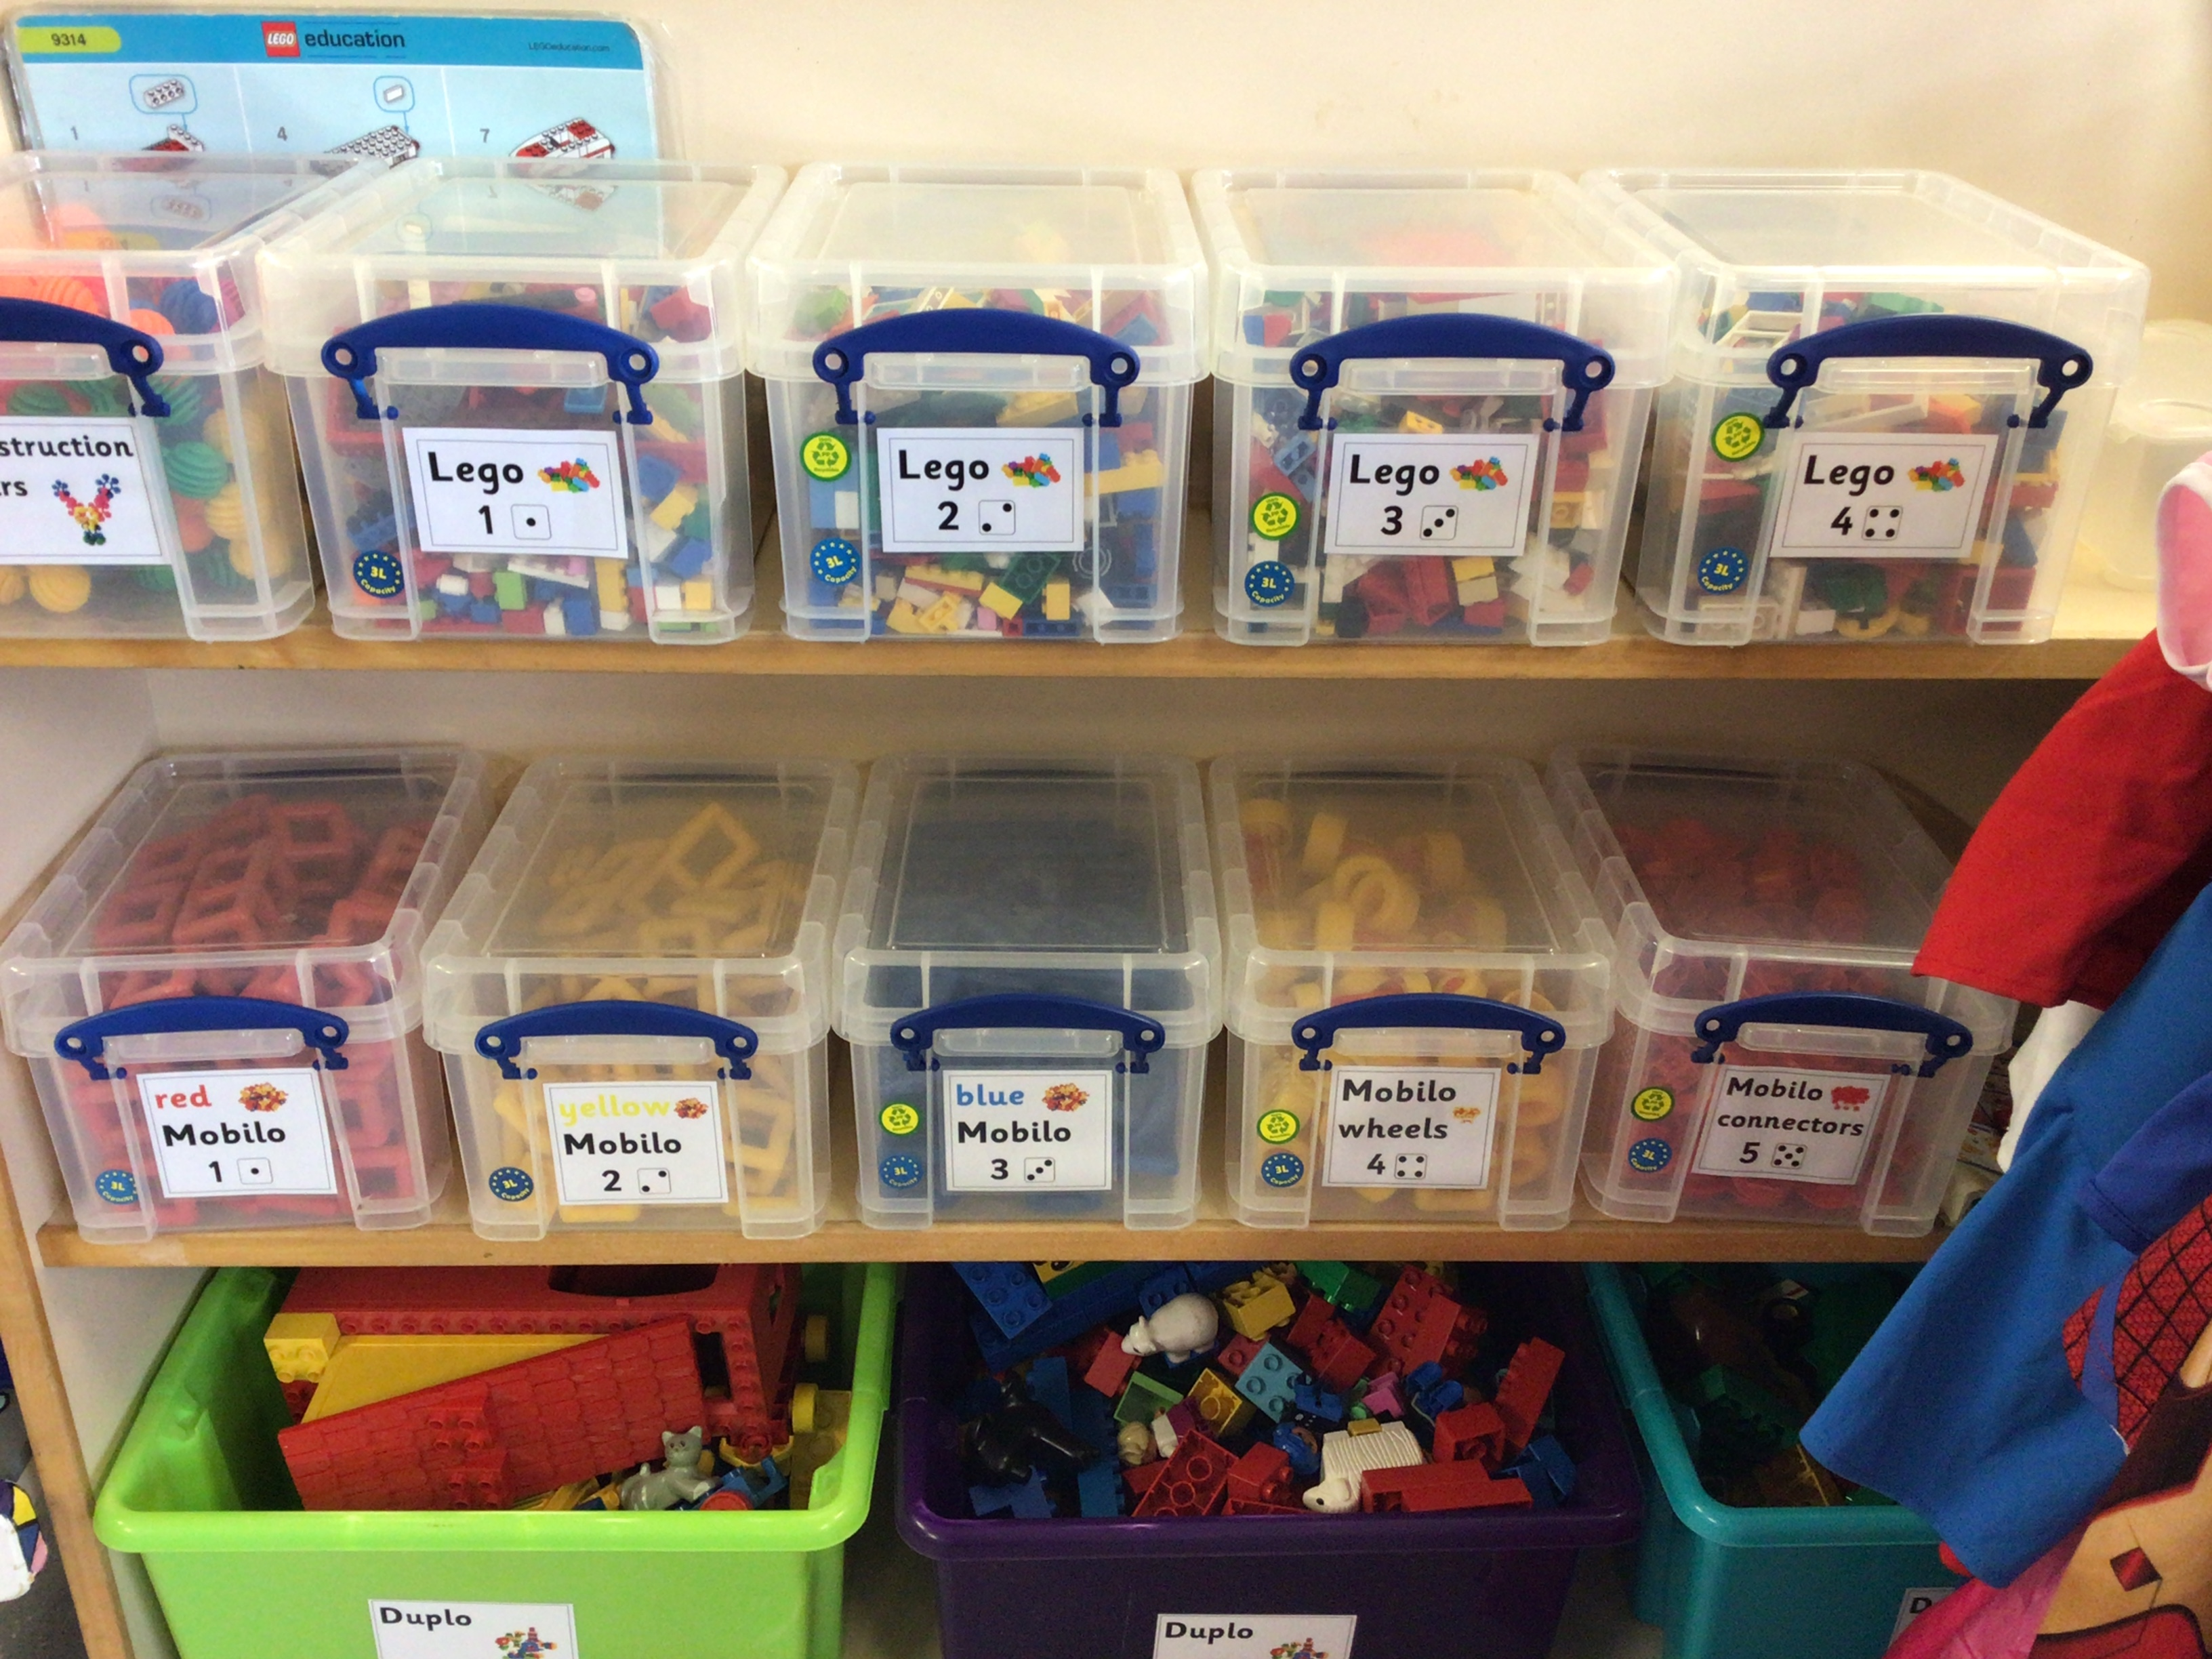
Maths in the classroom

Slide 23
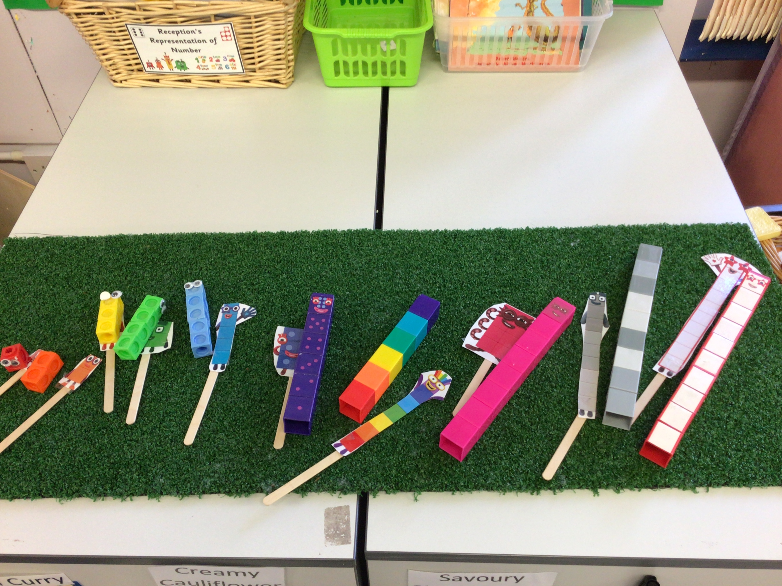
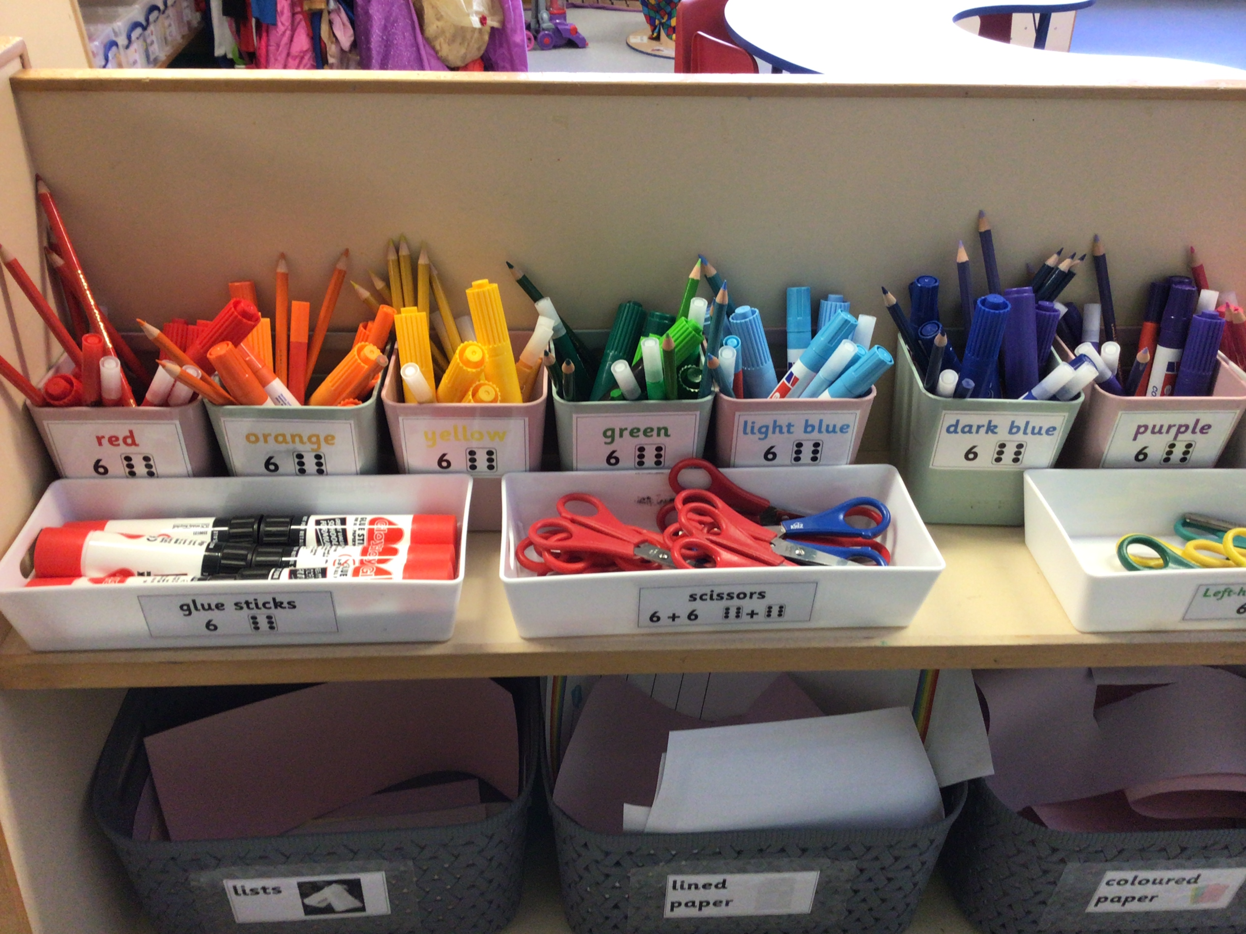
Maths in the classroom

Slide 24
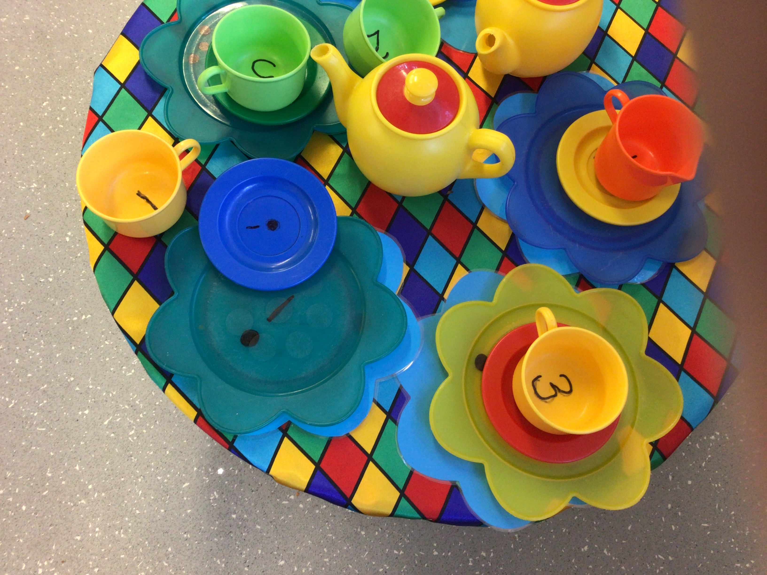
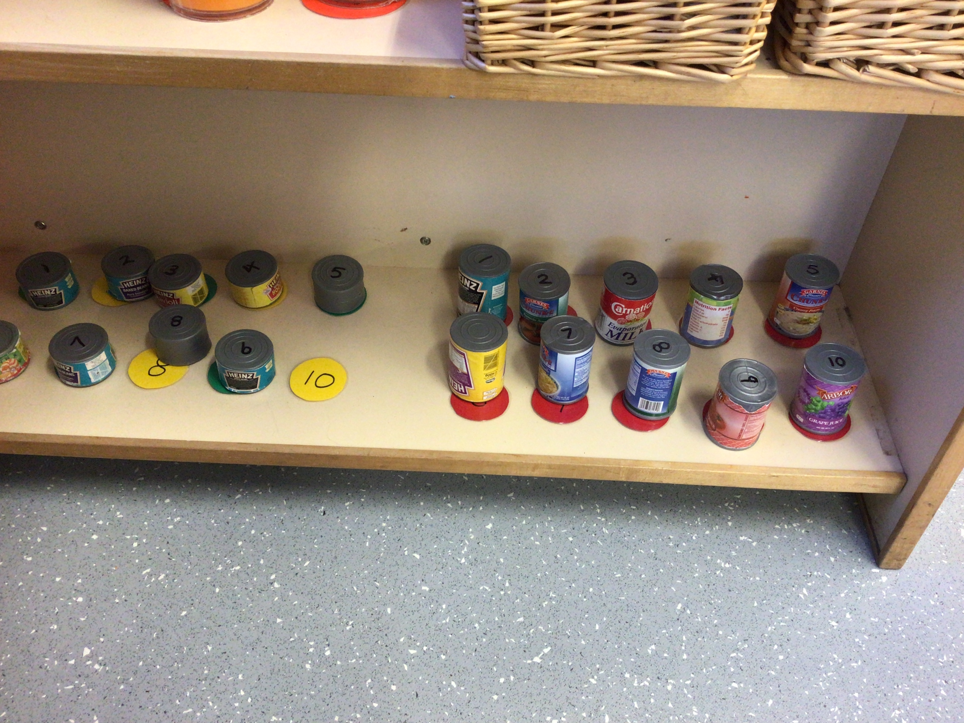
Maths in the classroom

Slide 25
Numberblocks

Slide 26
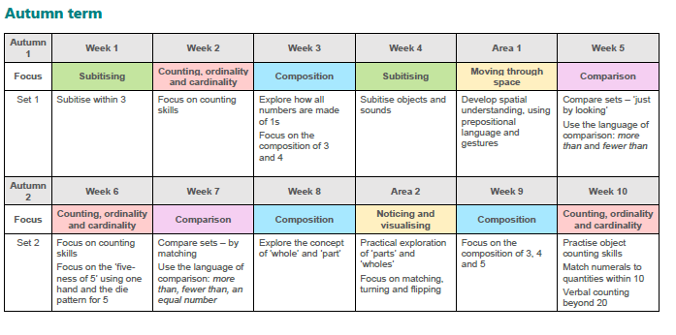

Slide 27
Helping at home
Fingers!
Subitising- play games
Ten frames
Counting accurately
Formation of numbers
Songs and rhymes- Five little ducks, ten green bottles, 5 current buns,

Slide 28


